Slide 1
Sorting Algorithms
UNCLASSIFIED

Slide 2
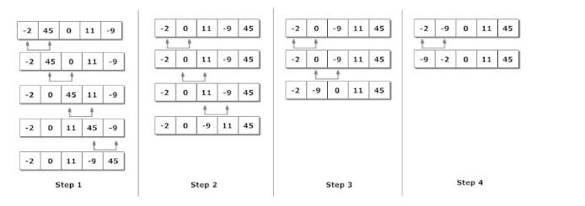
Bubble Sort
Notes:
Bubble sort algorithm starts by comparing the first two elements of an array and swapping if necessary, i.e., if you want to sort the elements of array in ascending order and if the first element is greater than second then, you need to swap the elements but, if the first element is smaller than second, you must not swap the element. Then, again second and third elements are compared and swapped if it is necessary and this process go on until last and second last element is compared and swapped. This completes the first step of bubble sort

Slide 3
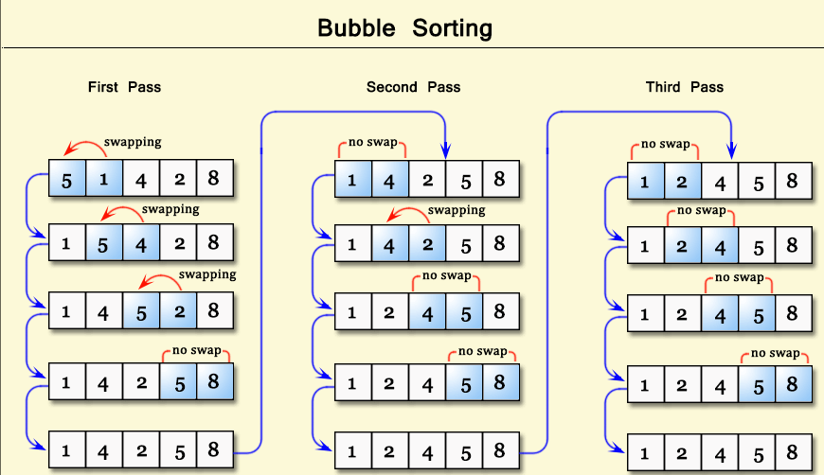

Slide 4
Bubble sort is simple yet effective sorting algorithm and hence it is quite popular when lists to be ordered are not very big. In bubble sort two successive elements are compared and are swapped if first element is greater than the second one.

Slide 5
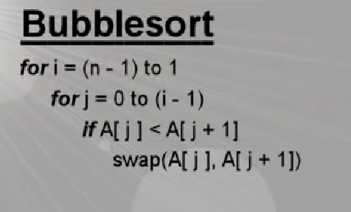


Slide 6
DEMO BUBBLE SORT LAB

Slide 7
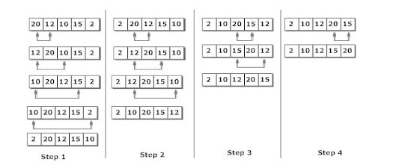
Selection Sort

Slide 8
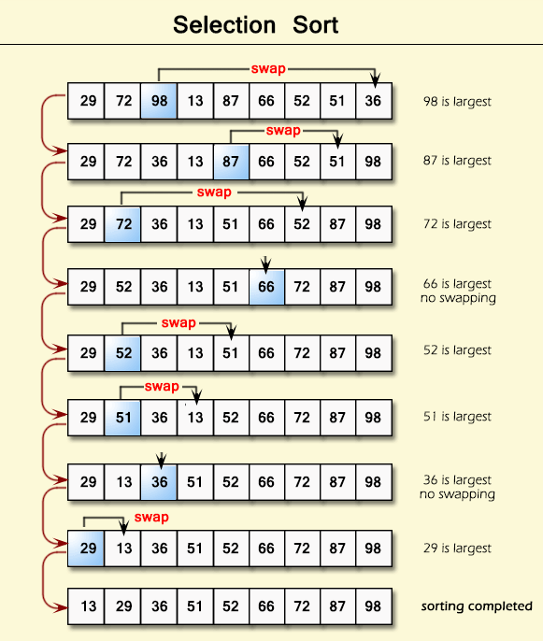

Slide 9
Selection sort algorithm starts by comparing first two elements of an array and swapping if necessary, i.e., if you want to sort the elements of array in ascending order and if the first element is greater than second then, you need to swap the elements but, if the first element is smaller than second, leave the elements as it is. Then, again first element and third element are compared and swapped if necessary. This process goes on until first and last element of an array is compared. This completes the first step of selection sort.

Slide 10
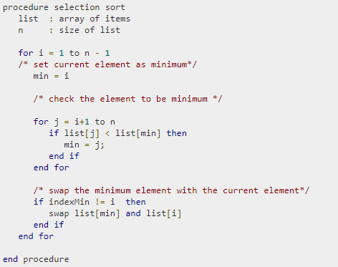


Slide 11
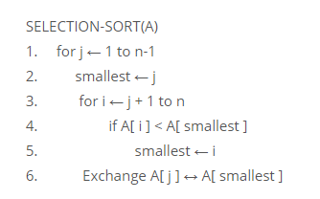

Slide 12
Selection Sort Demo
Selection sort Demo Lab

Slide 13
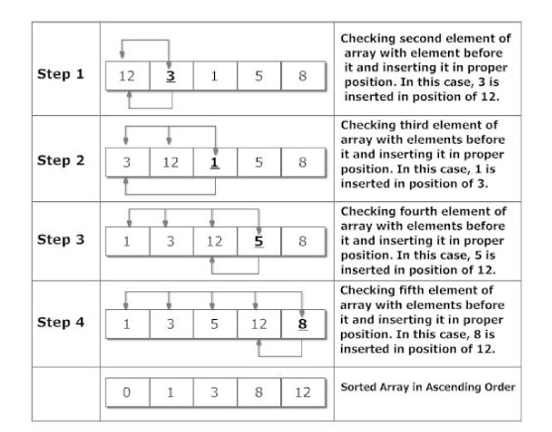
Insertion Sort

Slide 14
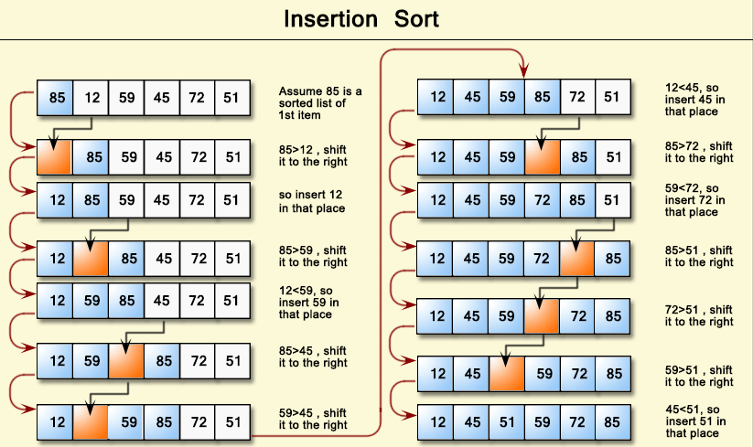

Slide 15
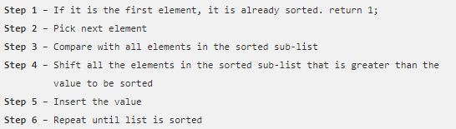
Insertion Sort

Slide 16
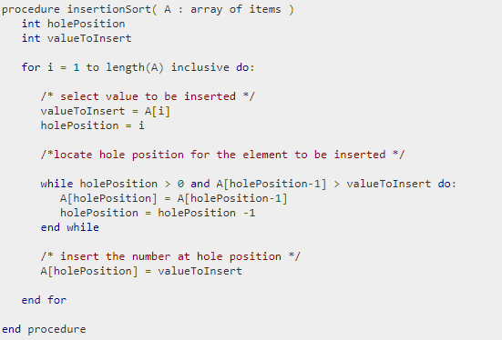
Insertion sort pseudocode

Slide 17

Insertion Sort equation

Slide 18
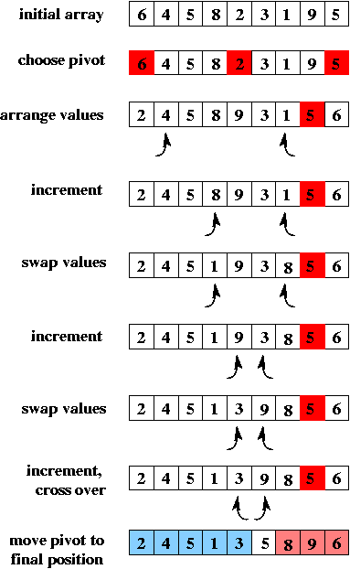
Quicksort Algorithm

Slide 19
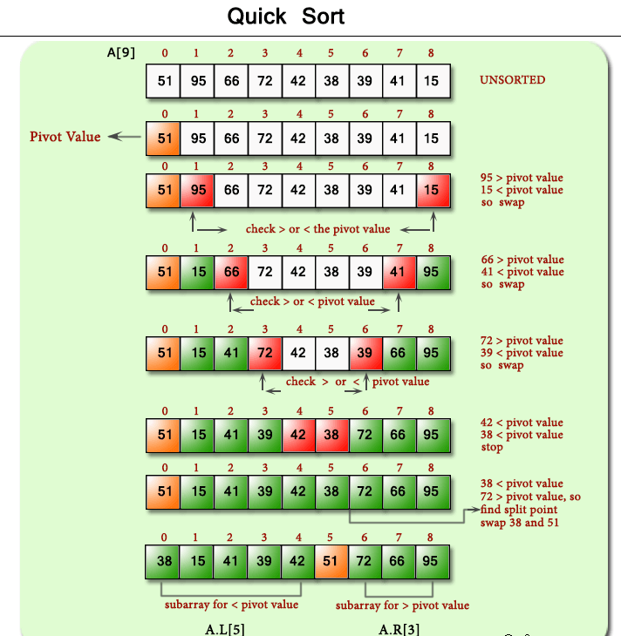

Slide 20
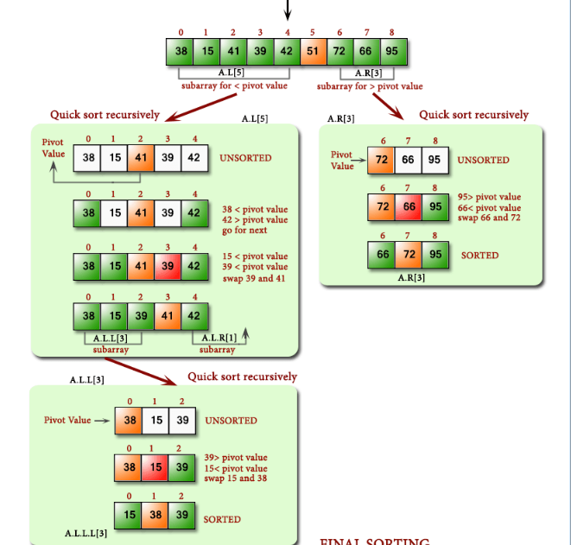

Slide 21
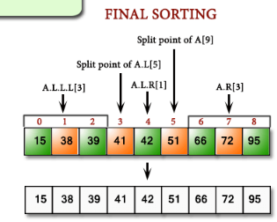

Slide 22
Quicksort
Quick sort is a highly efficient sorting algorithm and is based on partitioning of array of data into smaller arrays. A large array is partitioned into two arrays one of which holds values smaller than the specified value, say pivot, based on which the partition is made and another array holds values greater than the pivot value.

Slide 23
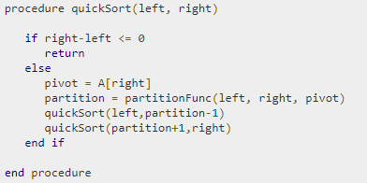

Slide 24

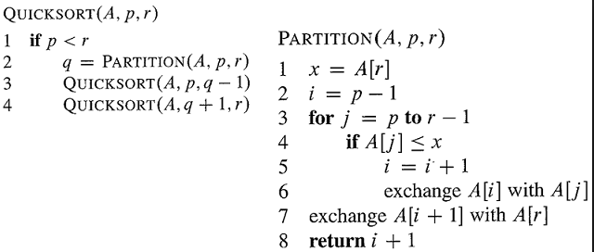

Slide 25
Quicksort Demo
Quicksort Demo Lab

Slide 26
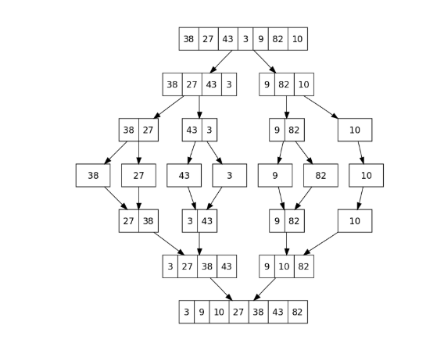
Merge Sort Algorithm

Slide 27
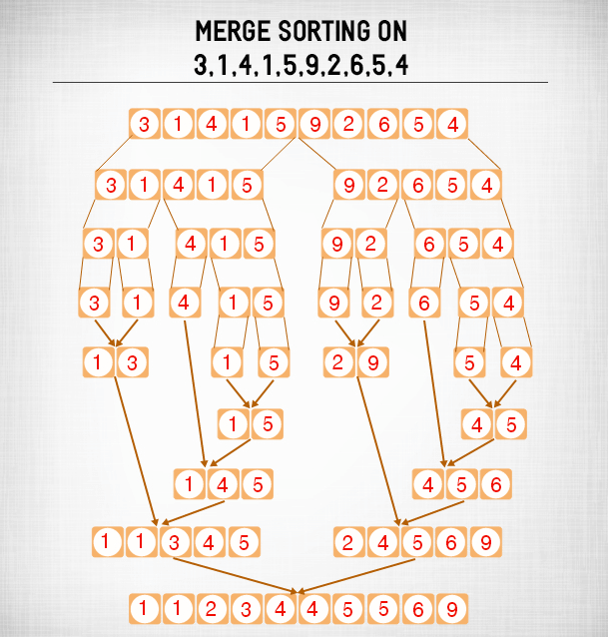

Slide 28
Merge Sort is a Divide and Conquer algorithm. It divides input array in two halves, calls itself for the two halves and then merges the two sorted halves. The merge() function is used for merging two halves. The merge(arr, l, m, r) is key process that assumes that arr[l..m] and arr[m+1..r] are sorted and merges the two sorted sub-arrays into one.

Slide 29
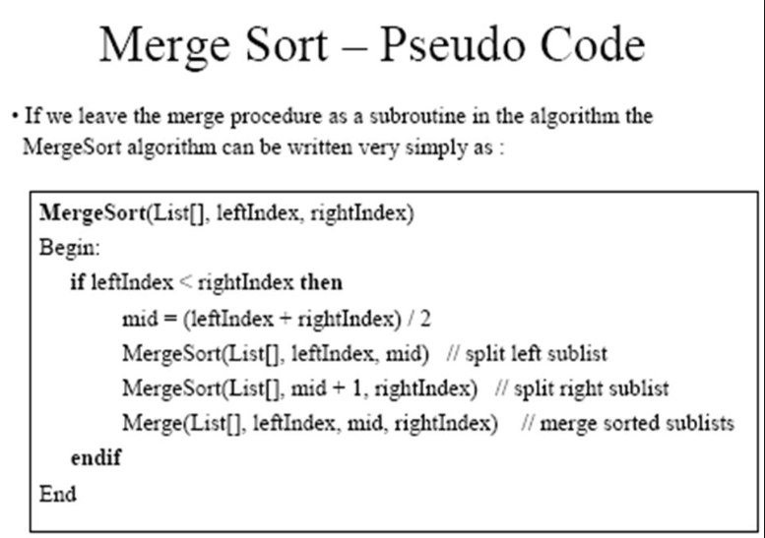
Merge Sort

Slide 30
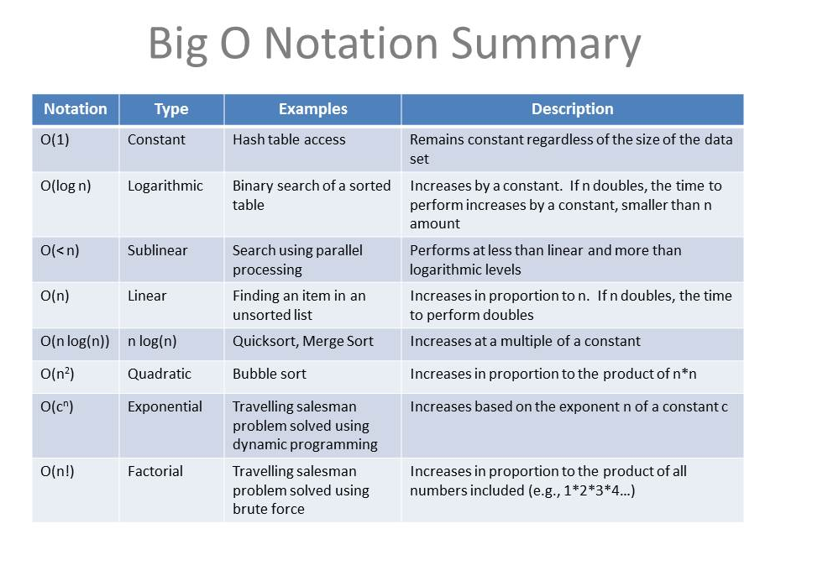

Slide 31
Mergesort demo
Merge sort demo lab

Slide 32
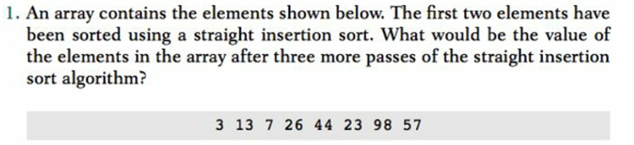

Slide 33
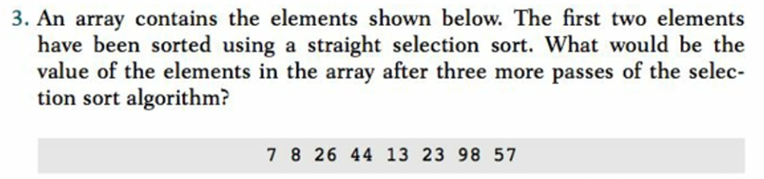

Slide 34
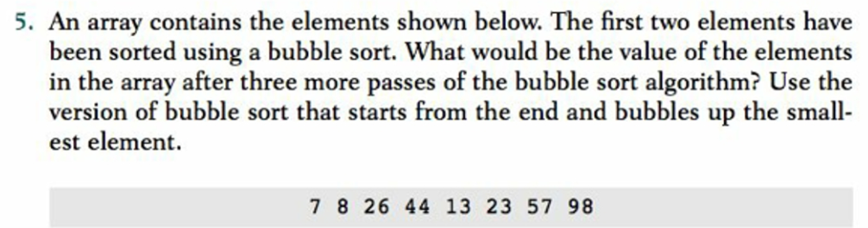

Slide 35
